Slide 1
PRODUCT RECOMMENDATION
SYSTEM

Slide 2


Meet the Team
Our dedicated 6-member team worked to bring the Product Recommendation System to life.
Sunitha
Govardhan Reddy Sunkara
Shaik Shamiulla
Pavan Dudi
Dharani A
M BHARATH KUMAR REDDY
Mentor: Karthik

Slide 3
Project Objective
Core Mission
Key Goals
Build an intelligent machine learning model that accurately predicts user preferences and delivers personalized product recommendations, transforming the customer shopping experience through data-driven insights.
Enhance customer engagement through tailored, relevant product suggestions
To create ML algorithms to understand user behavior patterns

Slide 4
Dataset Overview
78K
76K
40K
4
Total Records
Unique Users
Unique Products
Key Attributes
Comprehensive interaction data
Diverse customer base
Extensive catalog coverage
userid, productid, rating, date
Data Quality
Rating Scale
Zero missing values – complete dataset integrity
Ratings range from 1 (lowest) to 5 (highest), capturing full spectrum of user satisfaction levels.
No duplicate records detected
Clean, structured format ready for analysis

Slide 5
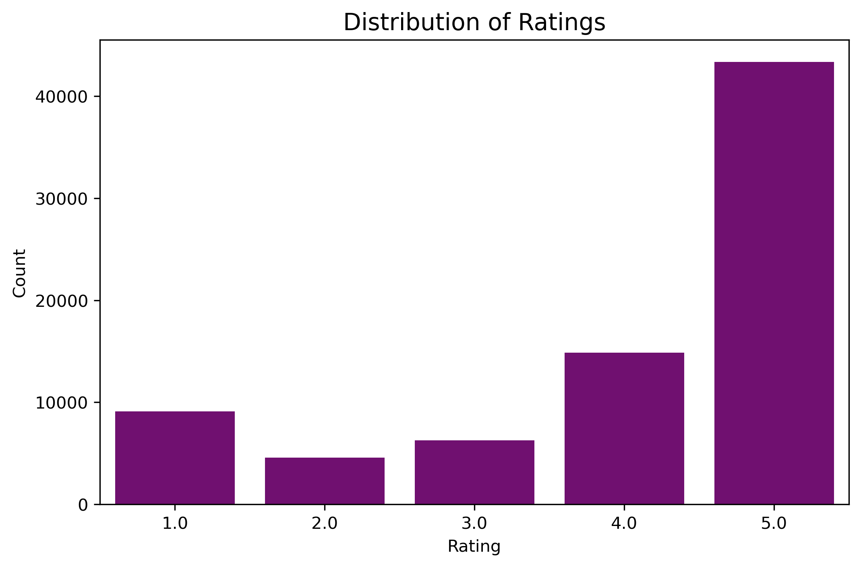
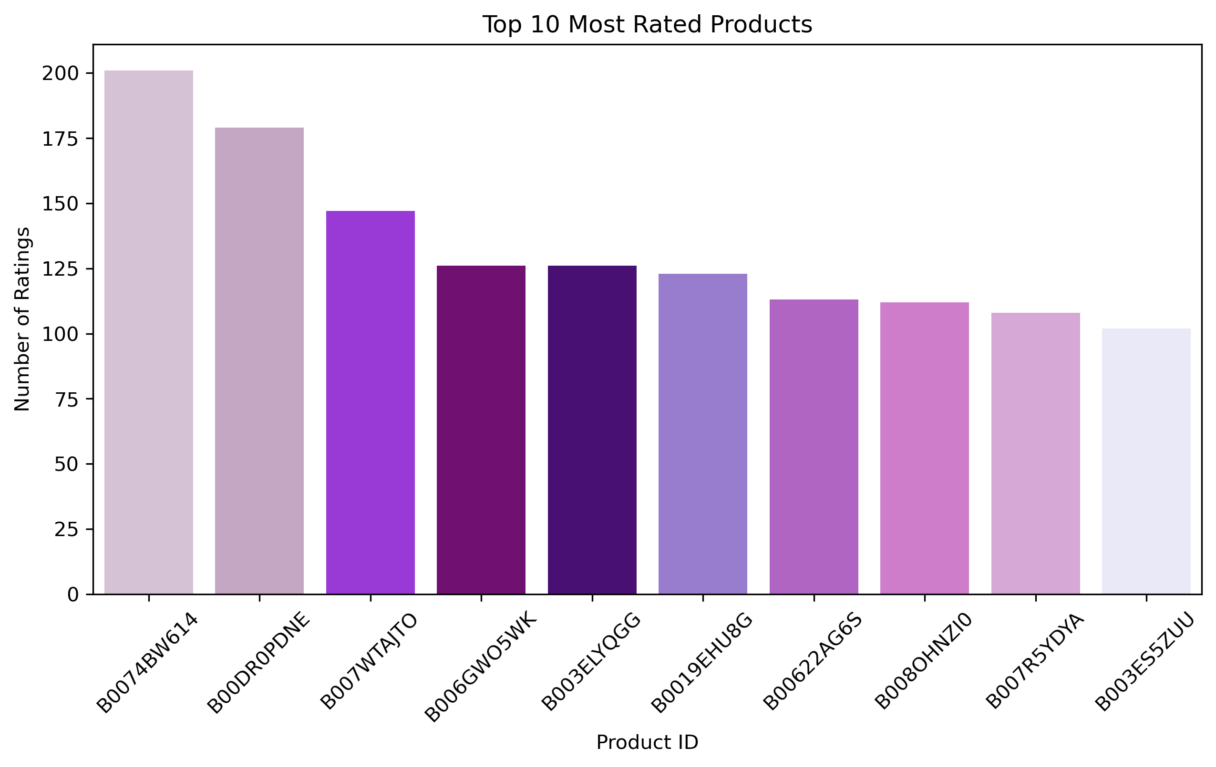
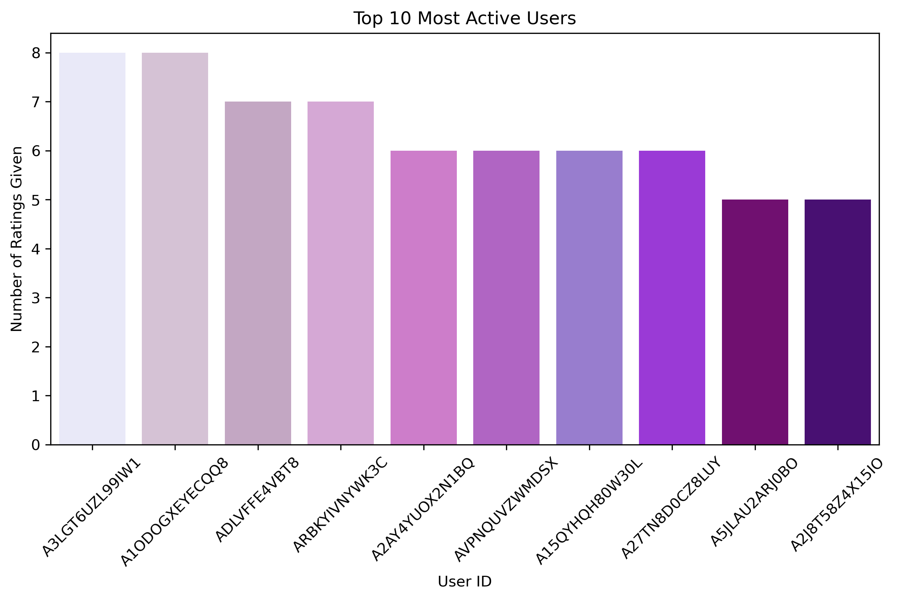
Exploratory Data Analysis
Rating Distribution
Top Products
User Activity
Our rating distribution clearly shows a strong positive trend, with the majority of user ratings clustering between 4 and 5 stars, highlighting high product quality and satisfaction.
Visualizations of top products confirm consistent high ratings, reflecting reliable quality and strong market appeal across our catalog.
User activity timelines reveal steady growth in platform engagement, with increasing participation and interaction rates over time.
Key visualizations include rating histograms, top product bar charts, user activity timelines, and engagement heatmaps that reveal critical patterns in customer behavior.

Slide 6

Distribution of Ratings
Rating 5 dominates the dataset, showing strong positive bias.

Slide 7
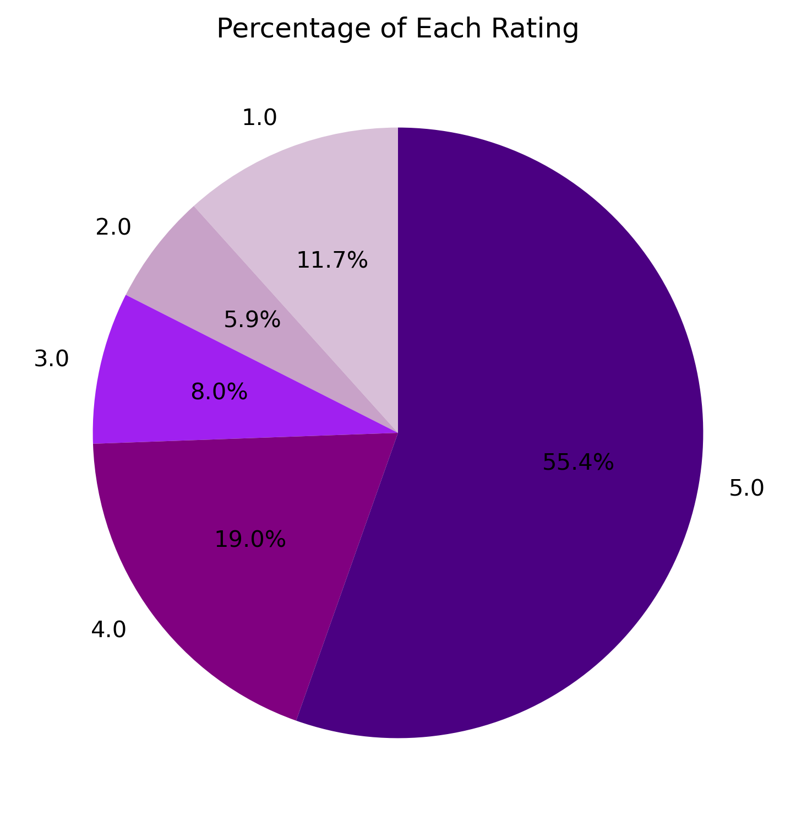
Percentage of Each Rating
4- and 5-star ratings account for the majority of feedback.

Slide 8
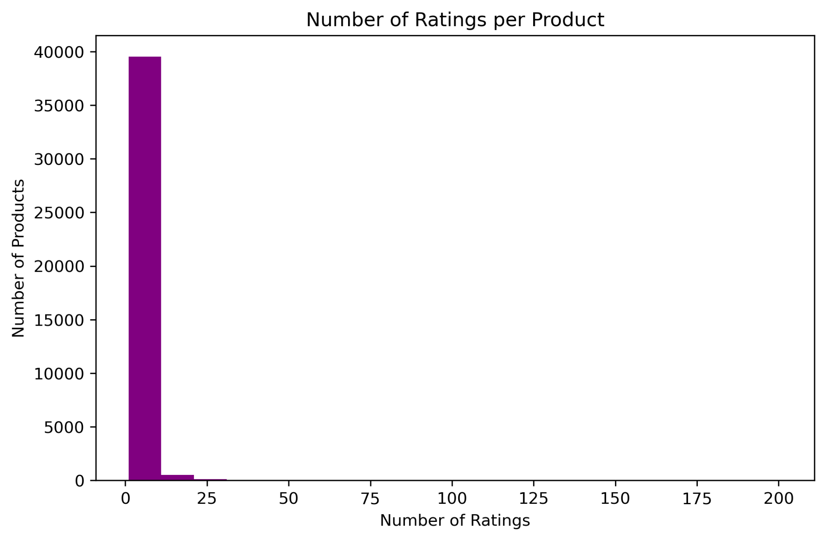
Number of Ratings per Product
Most products have very few ratings-long-tail distribution.

Slide 9
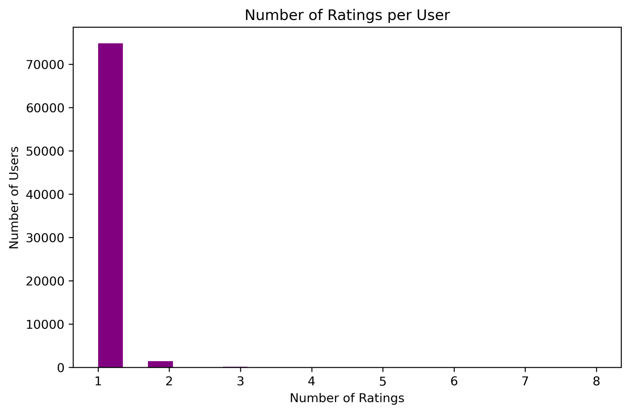
Number of Ratings per User
Most users rate only one product.

Slide 10

Top 10 Most Active Users
These users contribute the most ratings.

Slide 11

Top 10 Most Rated Products
These products are highly popular and widely interacted with.

Slide 12
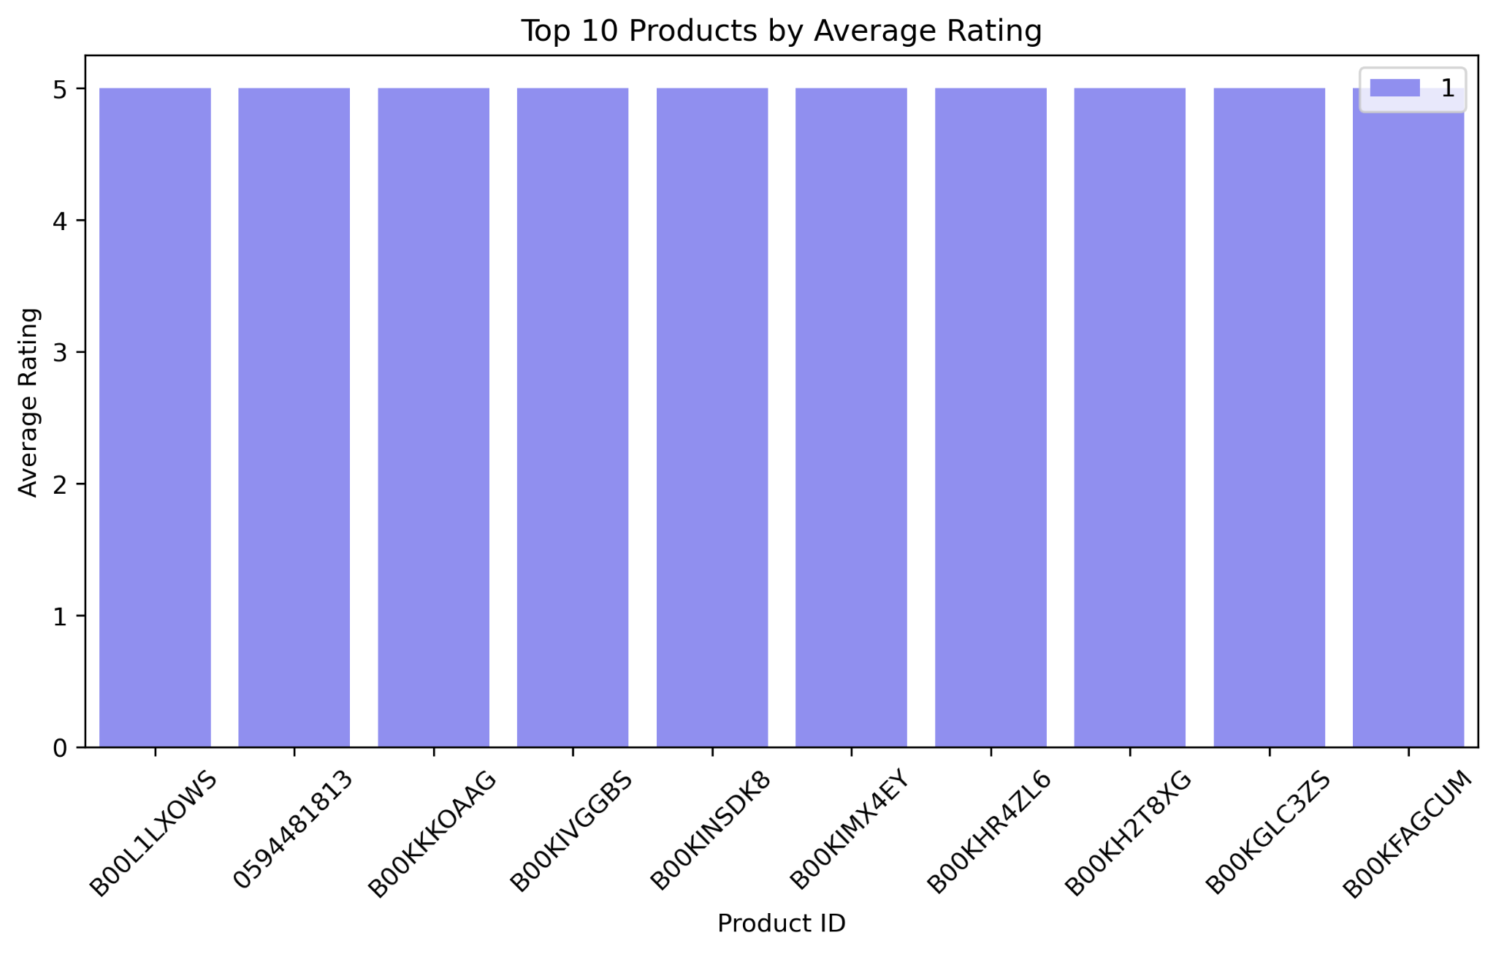
Top 10 Products by Average Rating
These products show the highest satisfaction scores.
EDA

Slide 13


Data Details & Key Findings
Most users interact with only a few products, resulting in a large amount of missing data – a common characteristic in recommendation systems.
While strong general connections were limited, we observed a key link between user activity levels and consistent average ratings.

Slide 14
Our Recommendation Models
Which Models We Used
We tested six different algorithms to find the best way to suggest products :
Logistic Regression
Random Forest
K-Nearest Neighbors
5. Naive Bayes
A basic program that predicts 'yes' or 'no' with a probability.
A simple program that uses probability to sort things.
6. Support Vector Machine
Uses many 'decision trees' together to get better results.
Finds the best line to separate different types of data.
7. Decision Tree
Guesses based on what similar users or items are doing.
Makes decisions like a flowchart, using a set of rules.

Slide 15
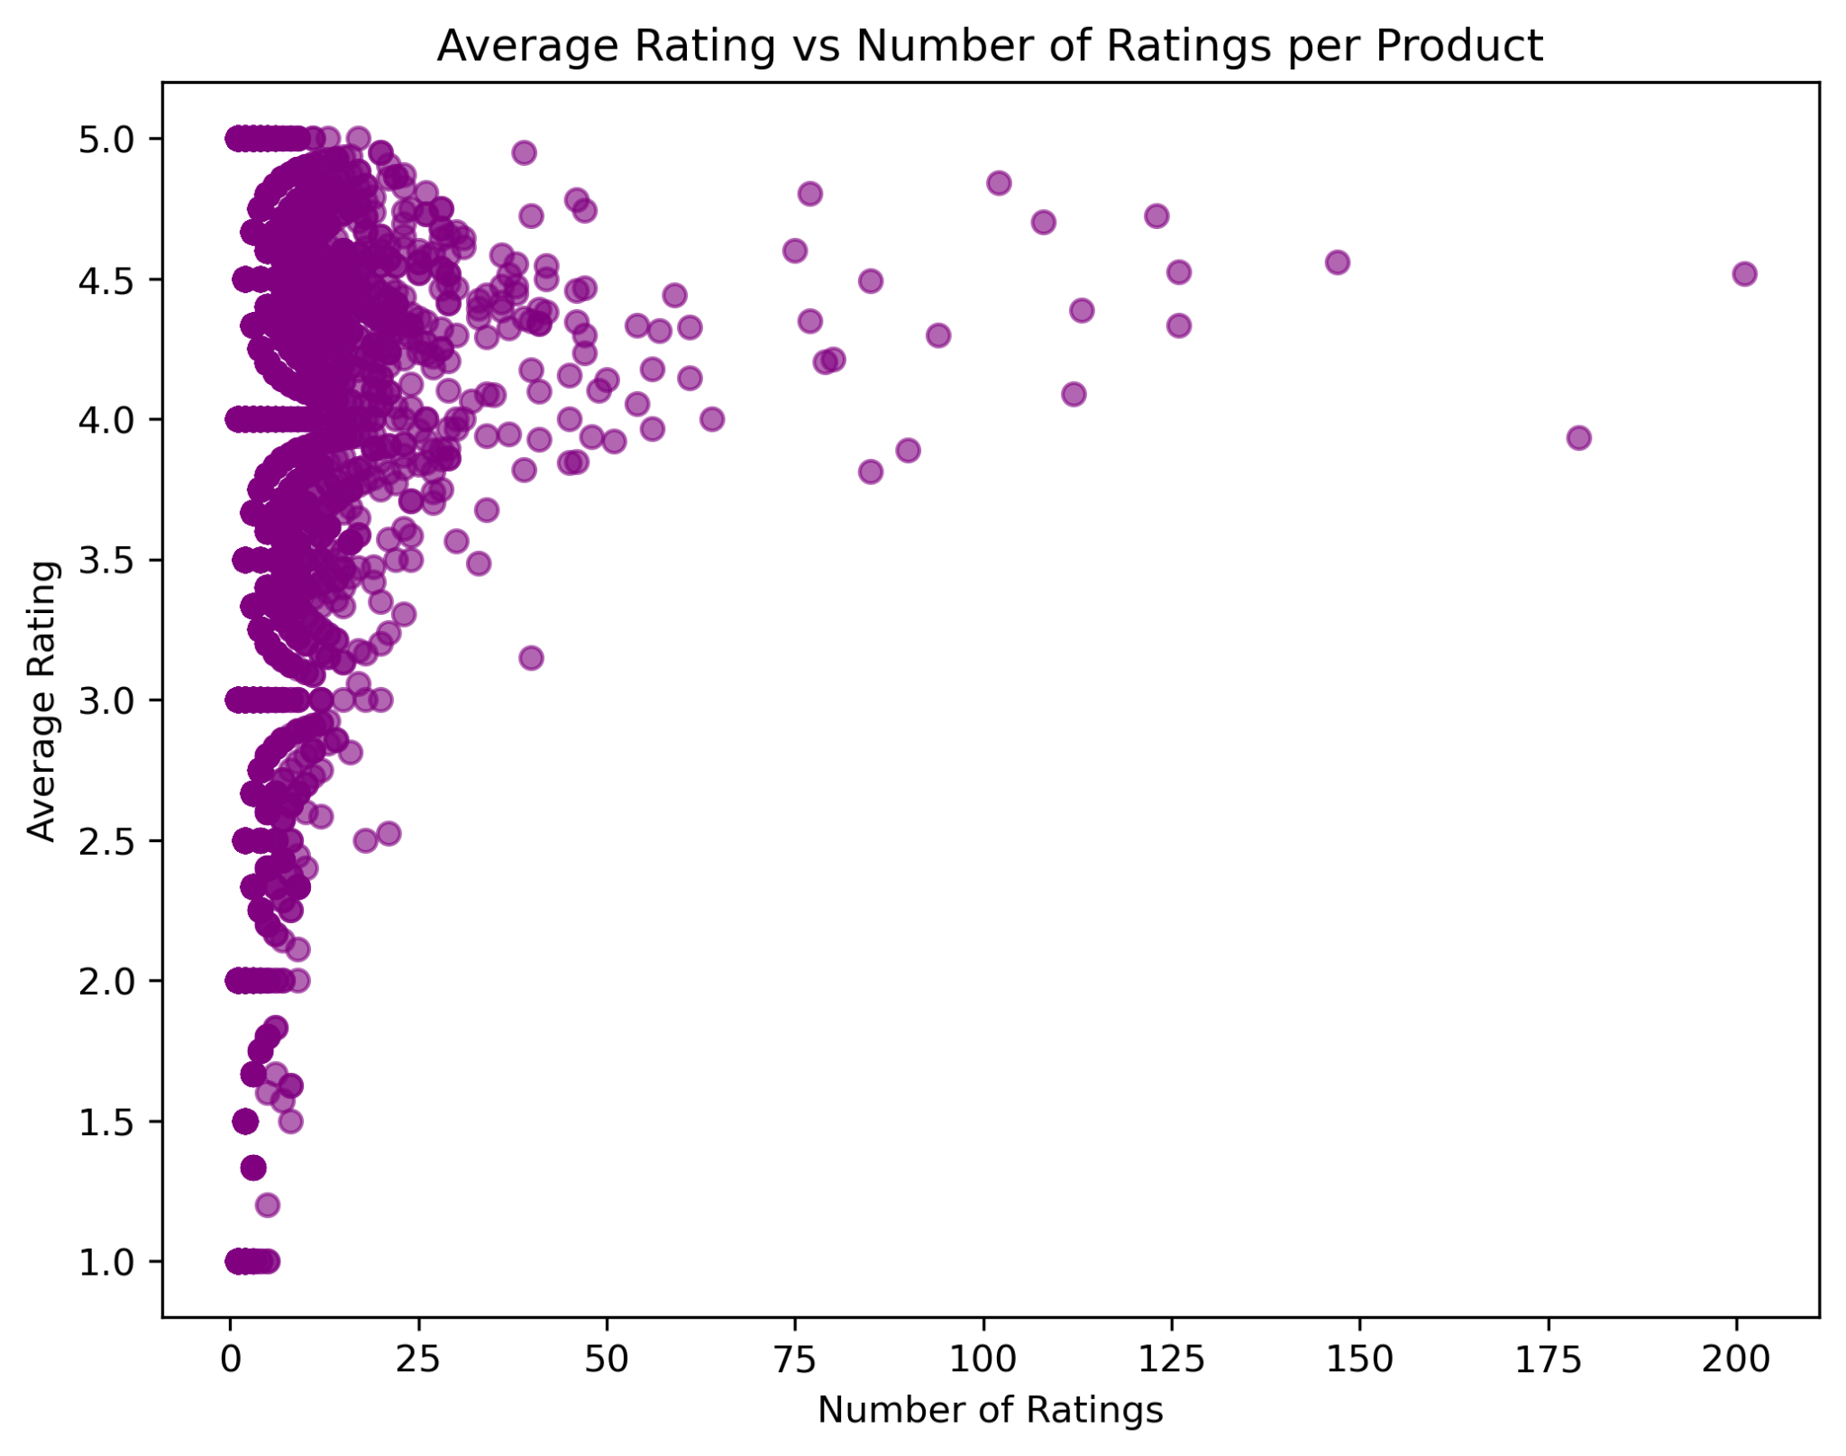
Average Rating vs Number of Ratings per Product
Heavily rated products cluster around 4–5 stars.

Slide 16
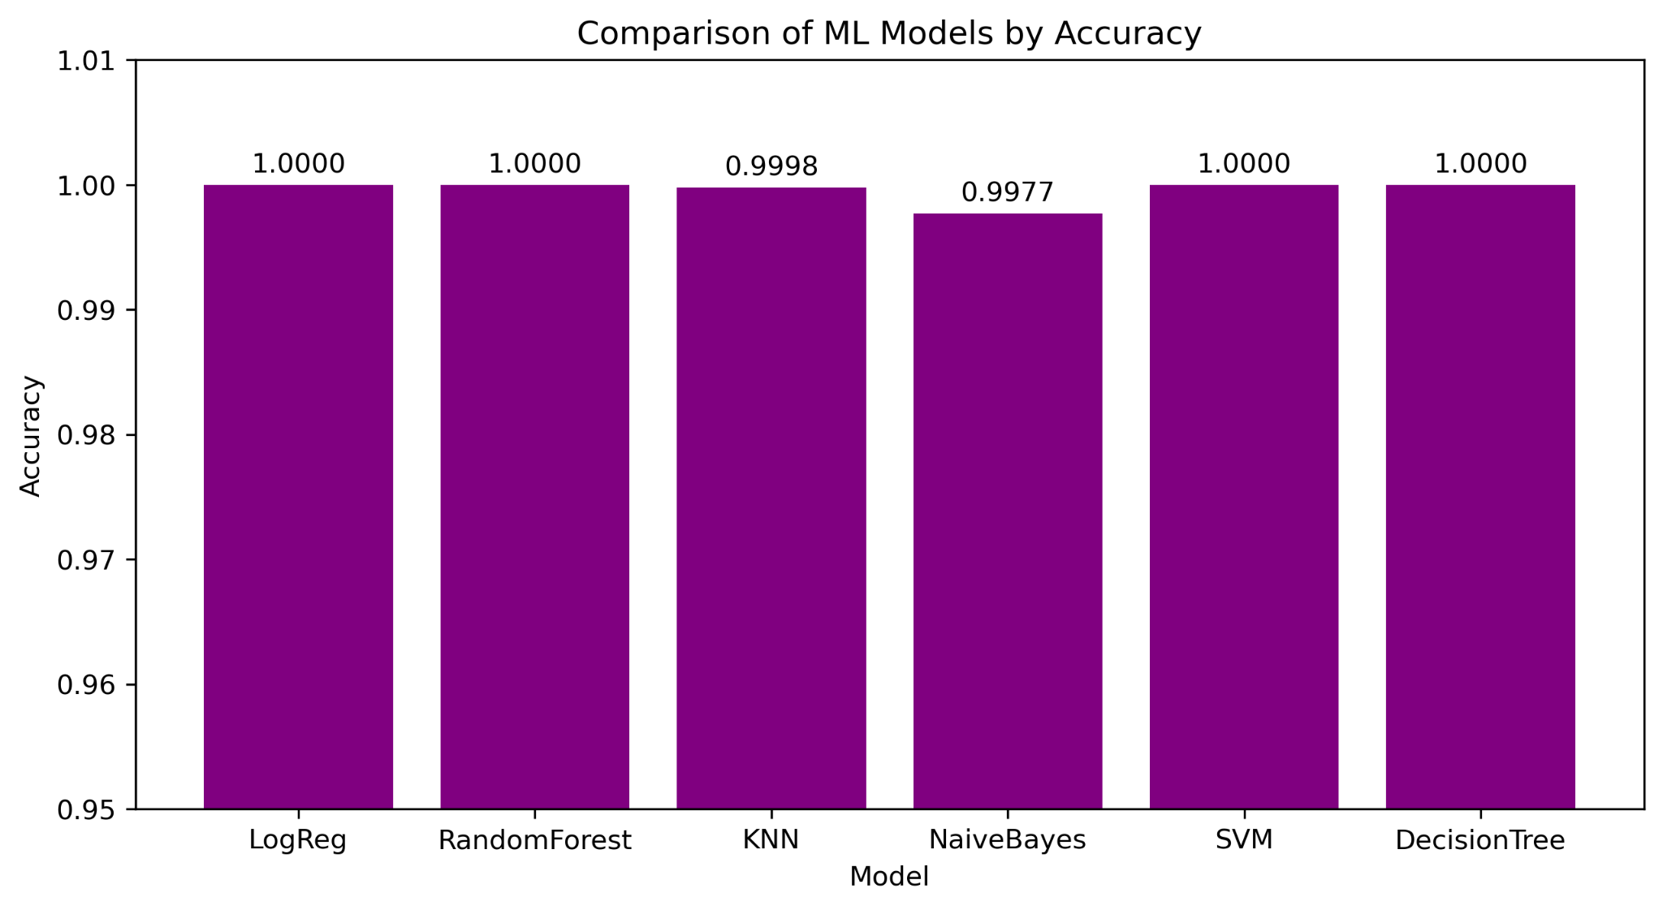
ML Model Comparison (Accuracy)
Insight: Most ML models reach ~100% accuracy.
Our evaluation revealed exceptional performance across multiple algorithms, with most models achieving near-perfect or perfect accuracy scores. The top performers – Logistic Regression, Random Forest, SVM, and Decision Tree – all reached 100% accuracy, demonstrating the strong predictive power of our feature engineering and model optimization approach.

Slide 17



Final Model Selection
Random Forest Classifier
Selected as the production model for deployment
Input
Processing
Output
User ID & Product ID
Random Forest Model
Top-N Recommendations

Slide 18
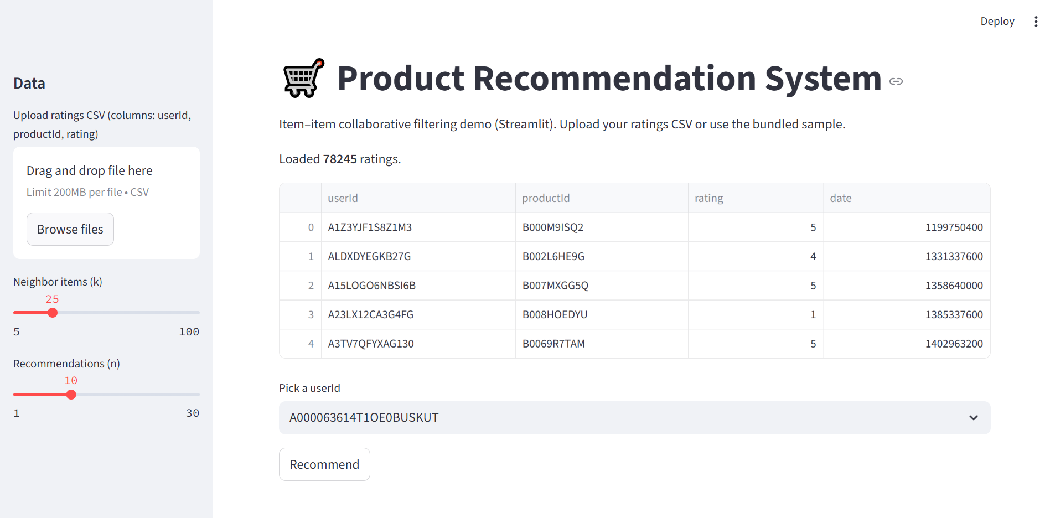
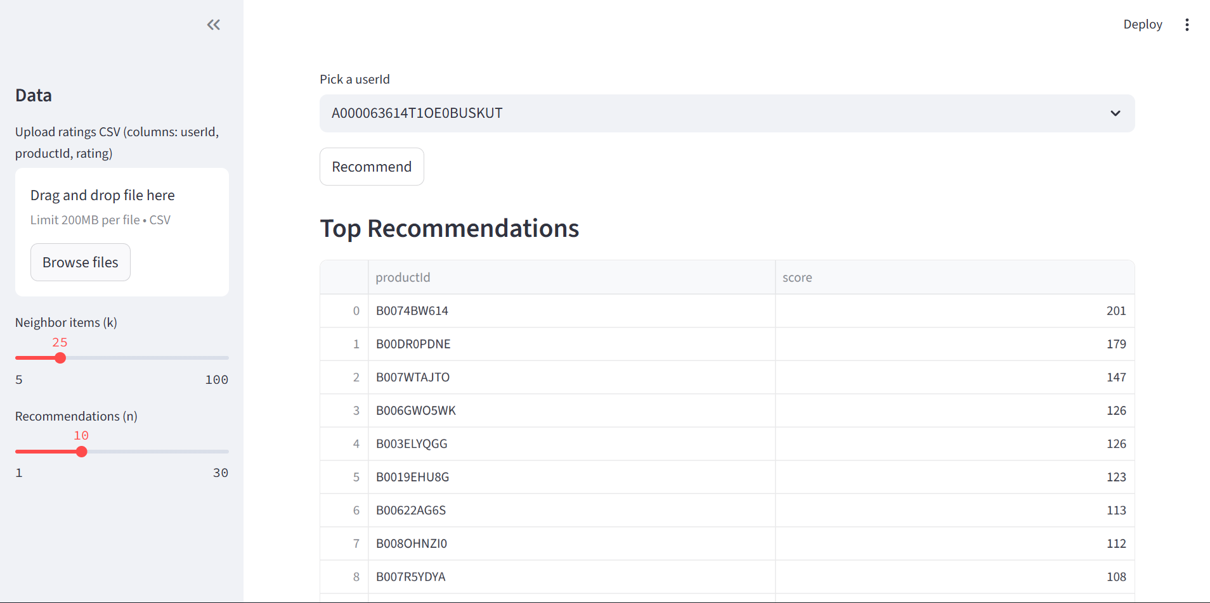
01
STREMLIT
http://localhost:8501/
Main User Interface
A clean and intuitive homepage displaying popular products and navigation options.
02
Personalized Recommendations
The results page showing tailored product suggestions based on user preferences and history.

Slide 19
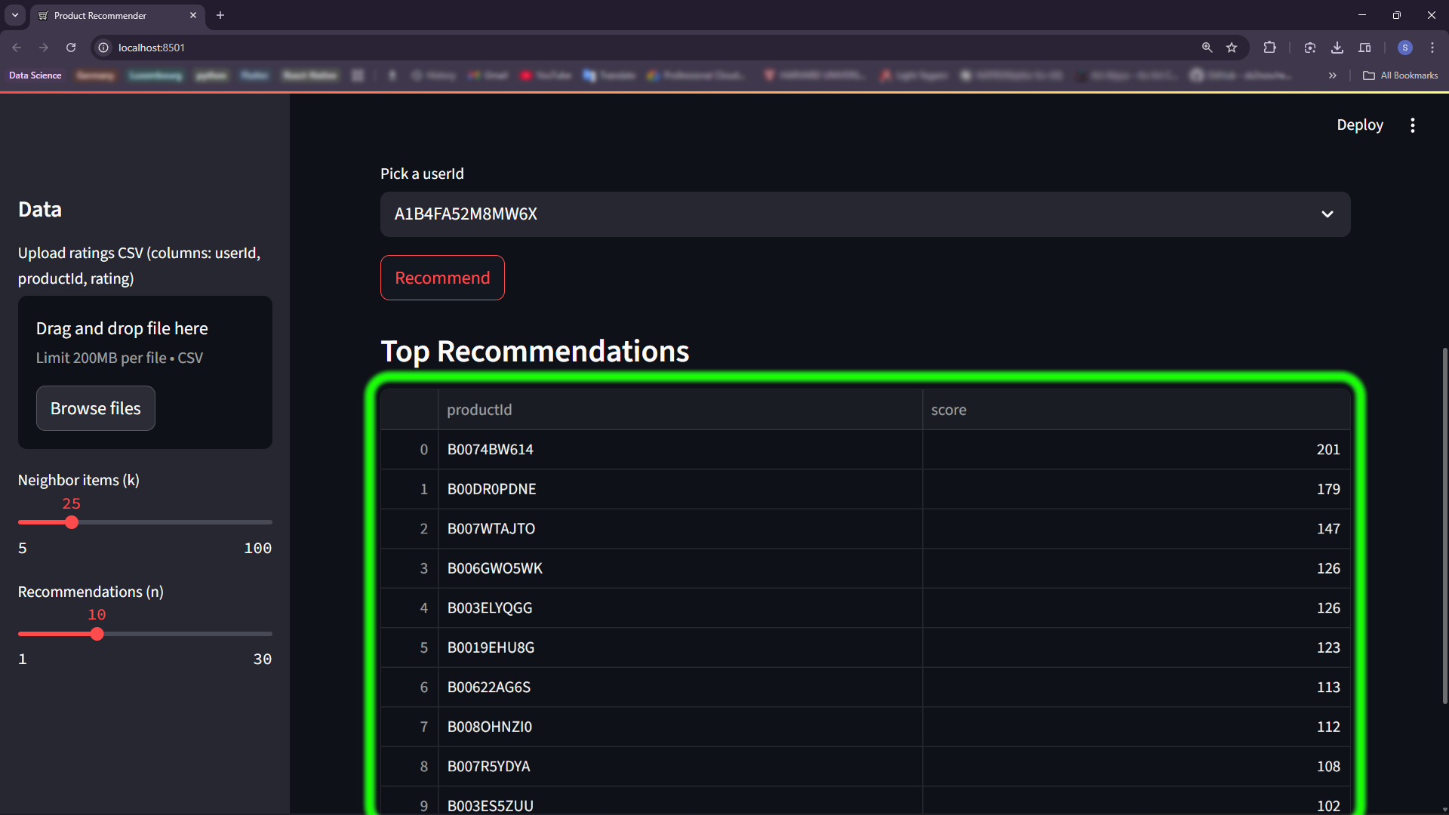
Personalized Recommendations
The results page showing tailored product suggestions based on user preferences and history.

Slide 20
THANK YOU
for your time

